Slide 1
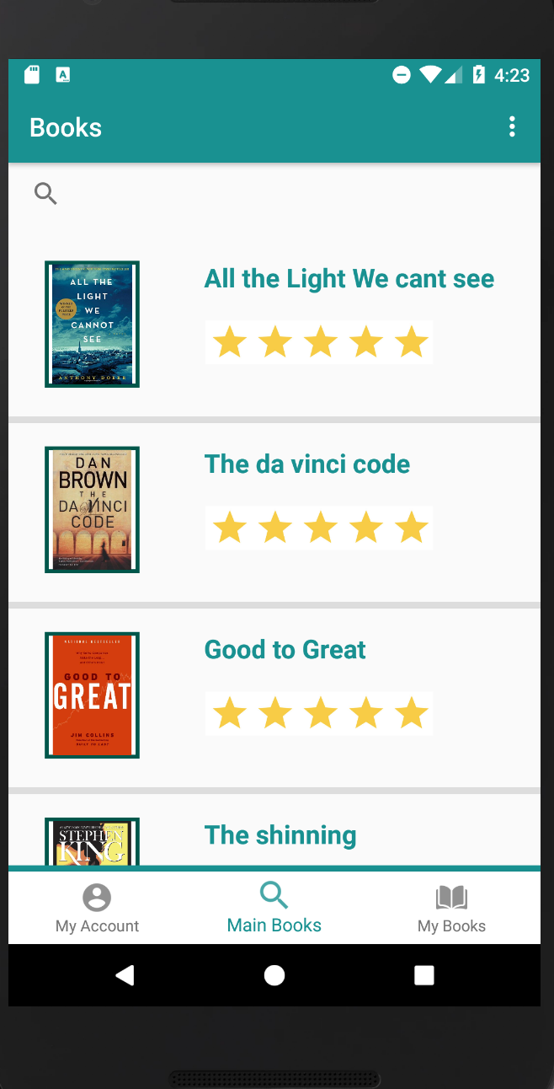

SHARE. App
Goals
Making an app that easies ownership of a book without having to pay the whole sum of money that the book costs.
Making it easier for people to get rid of books they don’t want anymore.
Giving the people a platform to give books away.
Giving the people a platform to sell and make money out of old books.
* Making it easier to get books that are related to education for students with half the price or less.

Slide 2
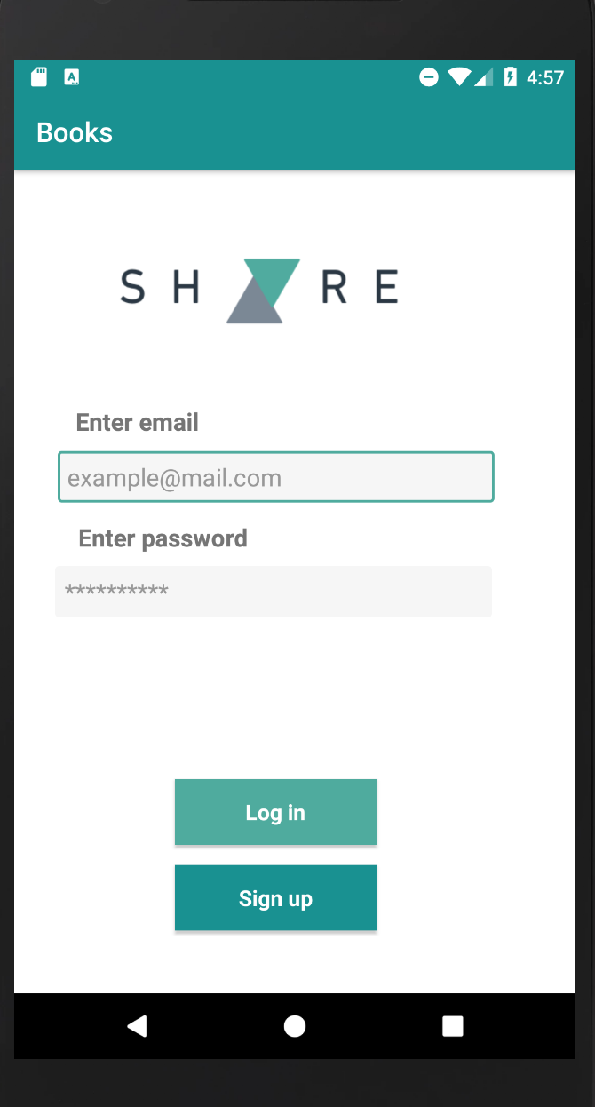
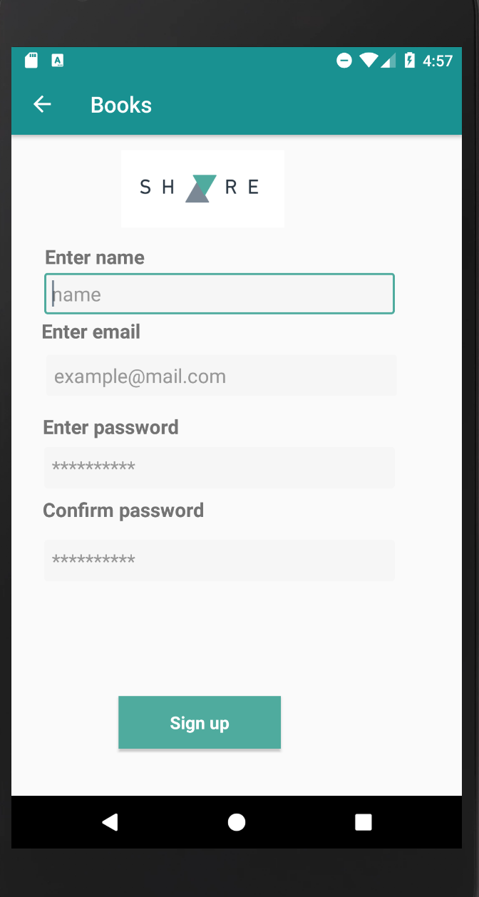
Log In Page
Sign Up Page

Slide 3

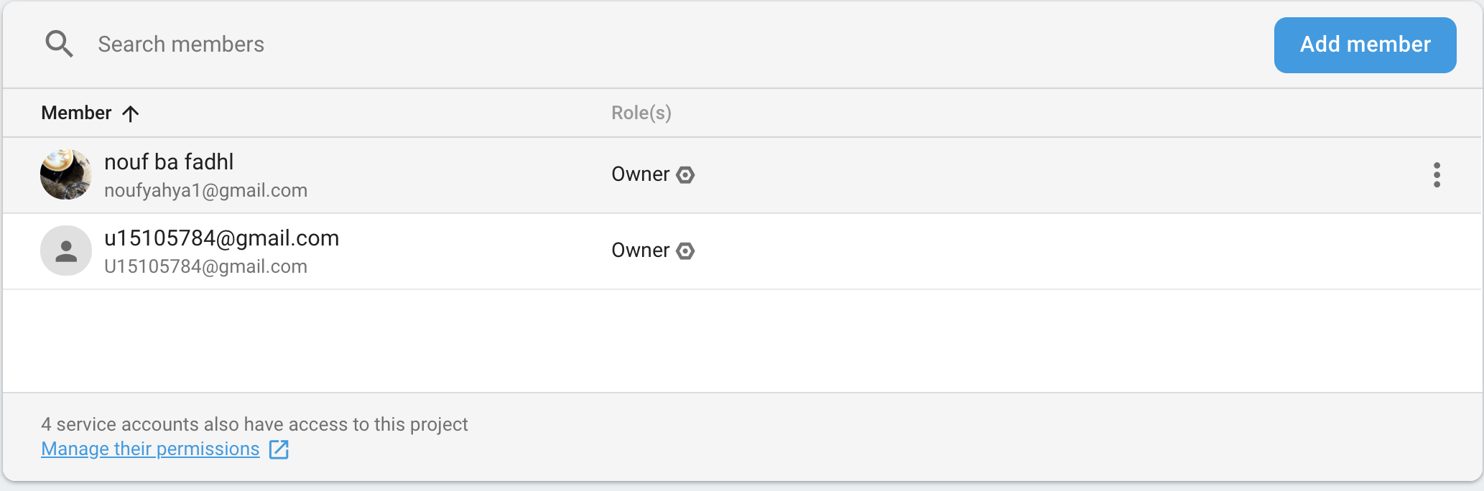
Firebase Database
Firebase has created a beta version recently which is a cloud database system that has more security and privacy since you can limit the people who can view the database.
In our app it’s limited to myself Nouf yahya and Afra hamad.

Slide 4
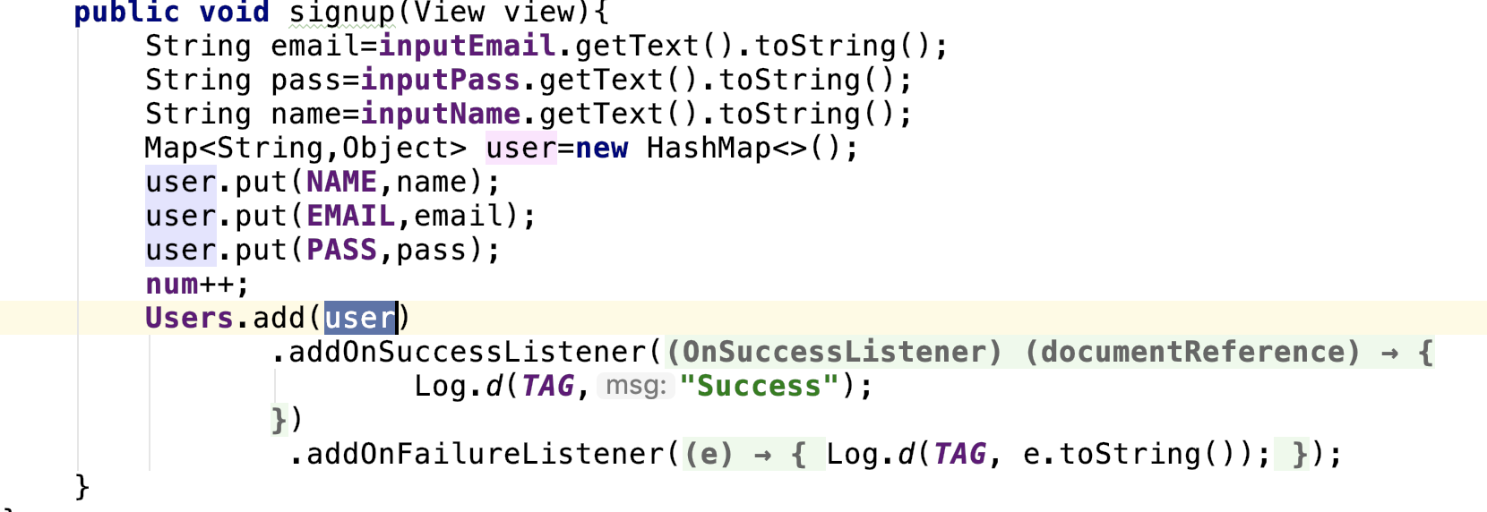
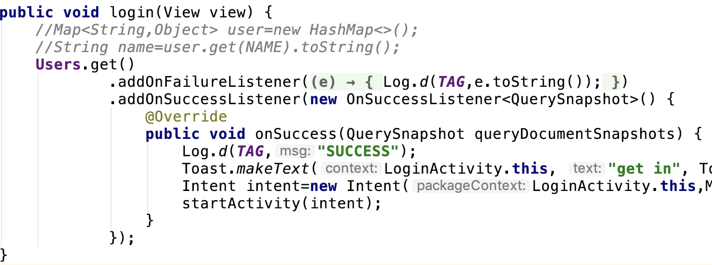
Firebase Database
Sign Up
Sign In

Slide 5
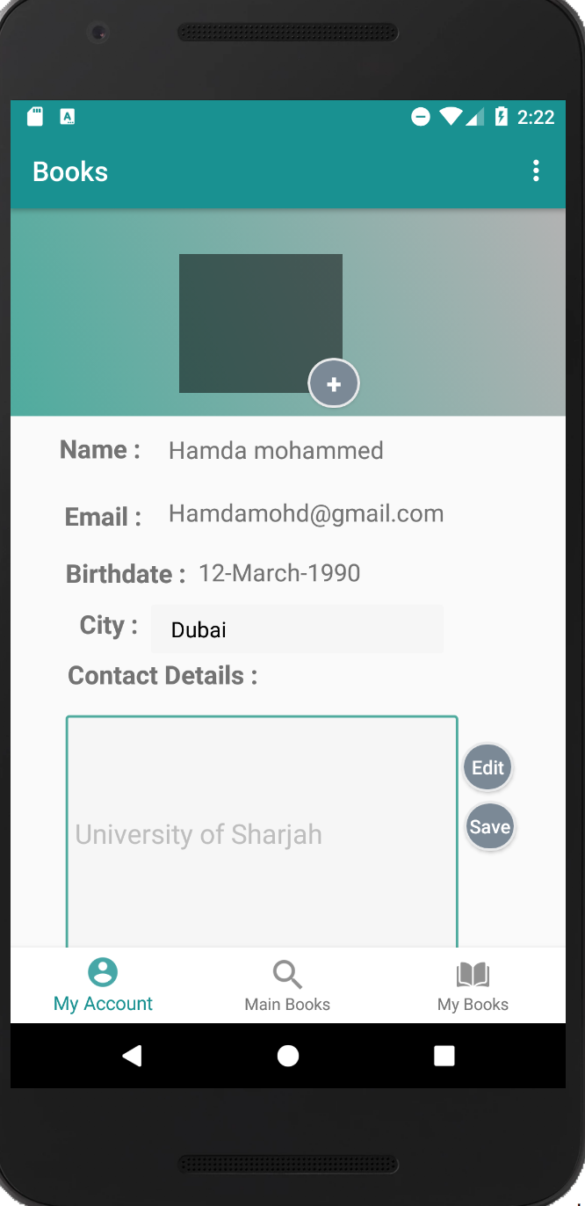
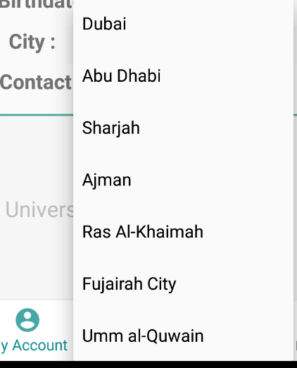
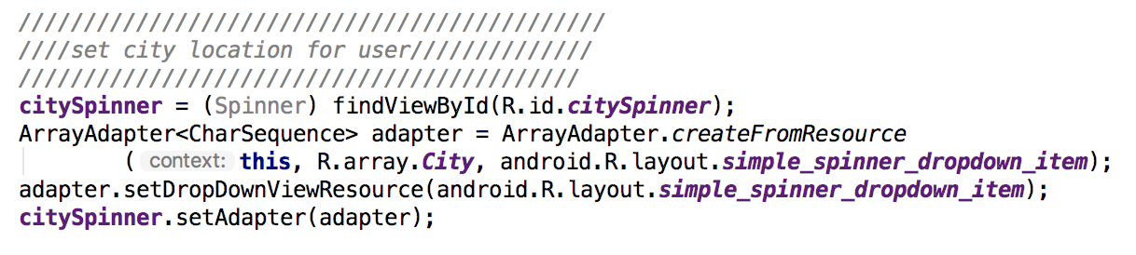

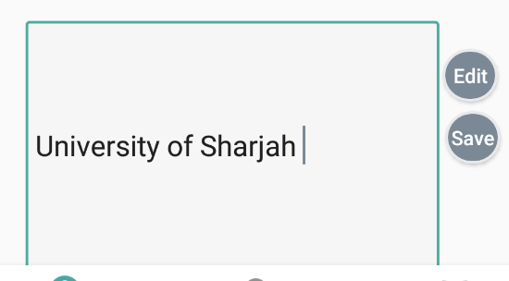
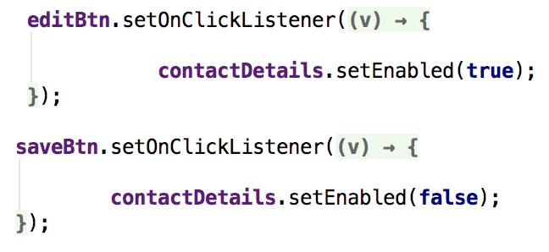
Account Details Page

Slide 6
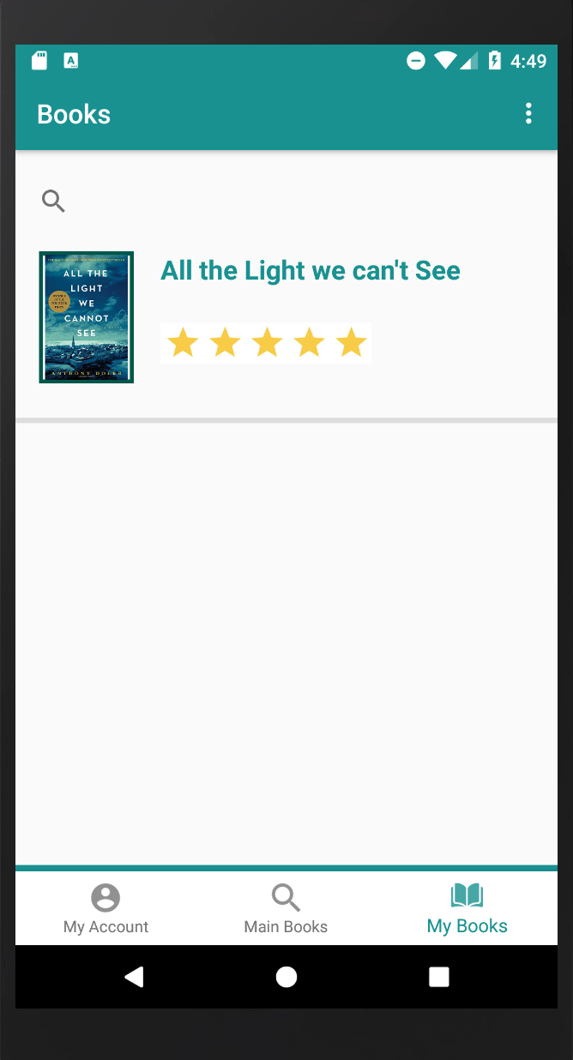
Book ListView
My Book page

Slide 7
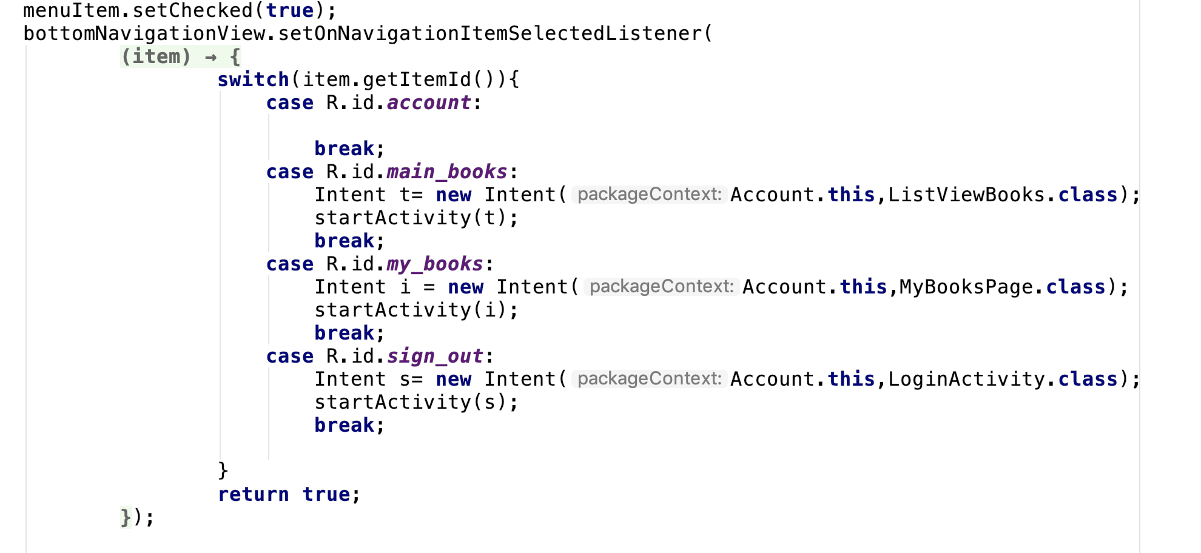

Bottom Navigation

Slide 8
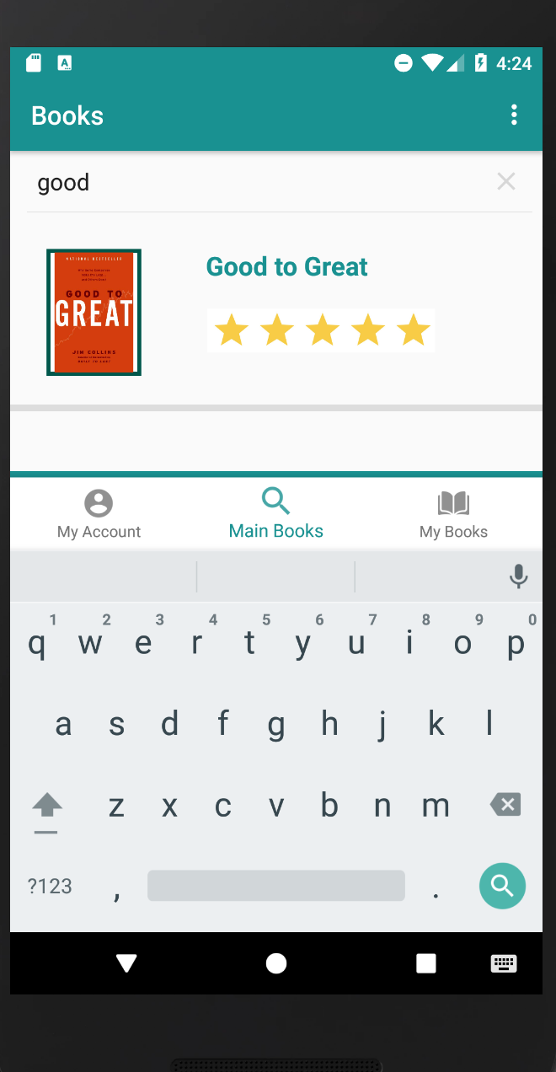

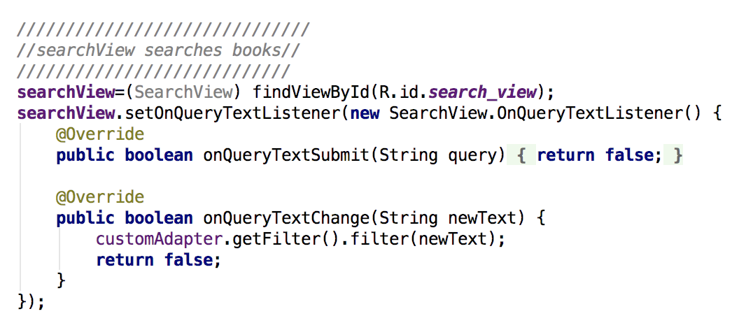
Search Field

Slide 9
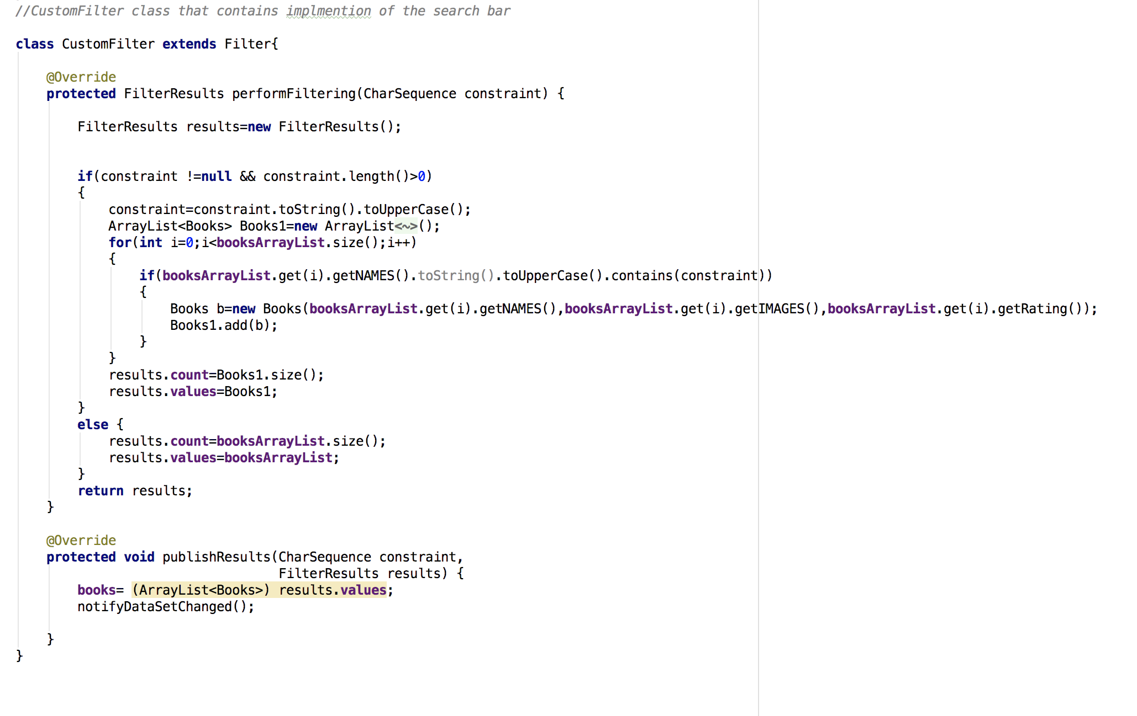
Search Field

Slide 10
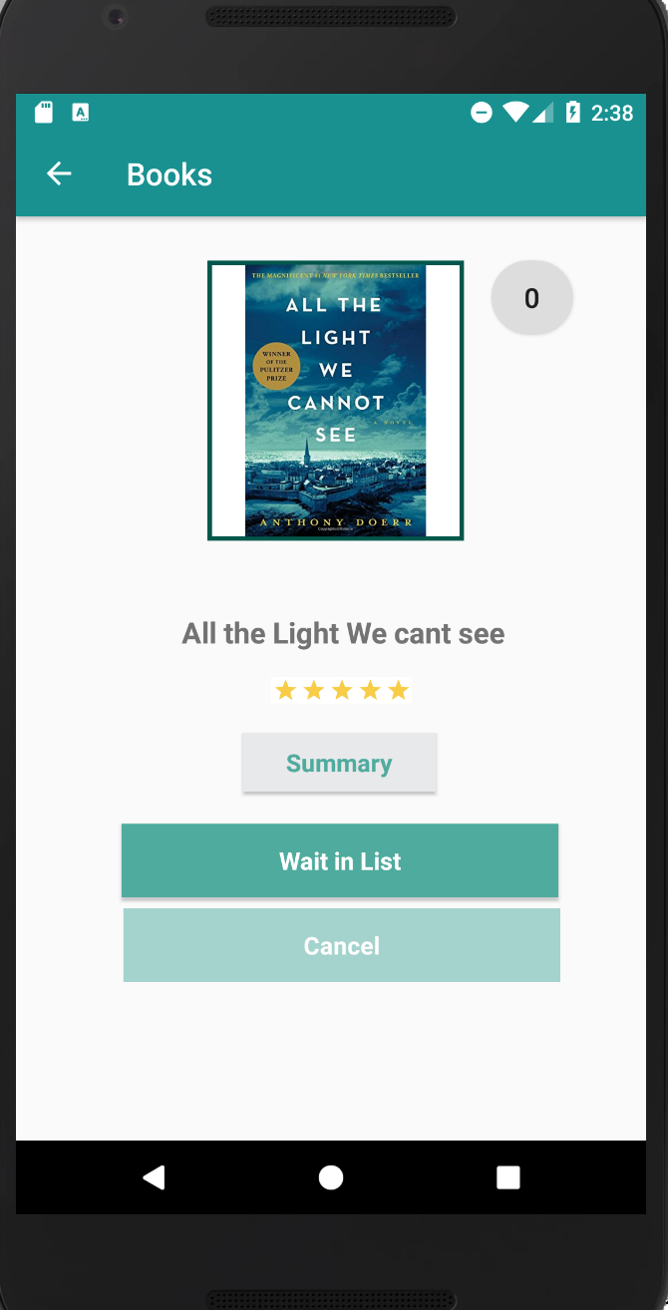
Details Page

Slide 11
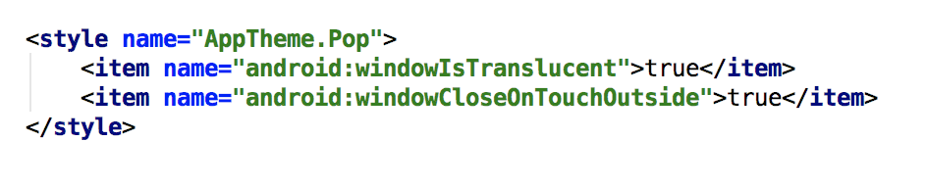
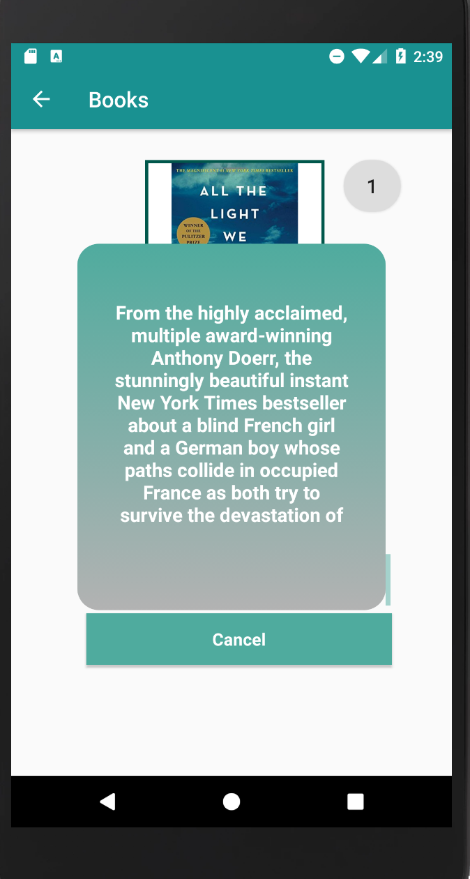
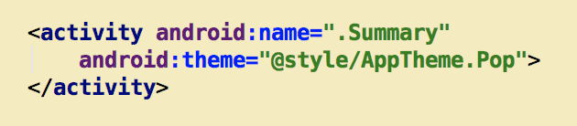

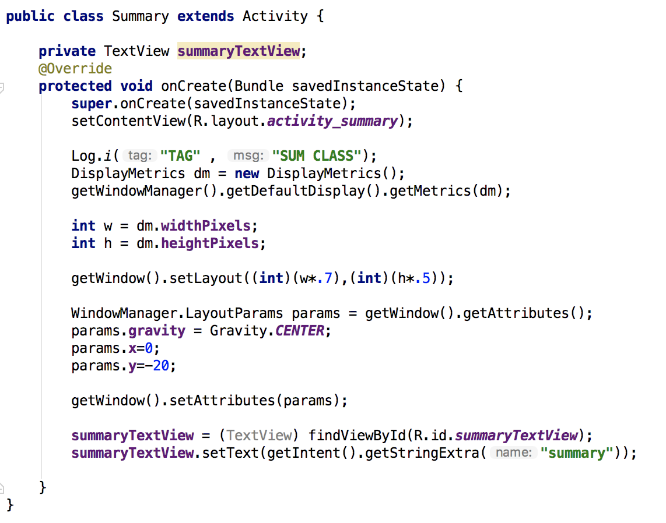

Details Page

Slide 12
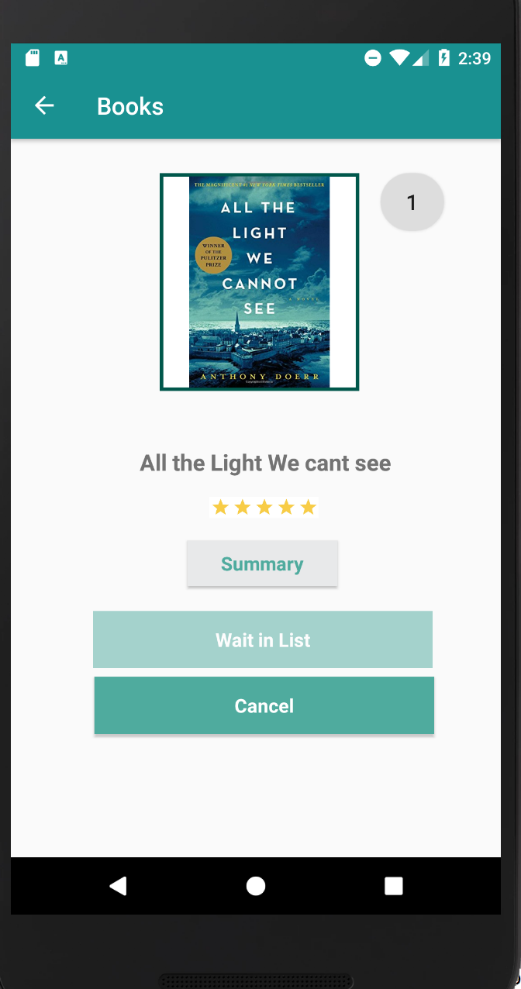
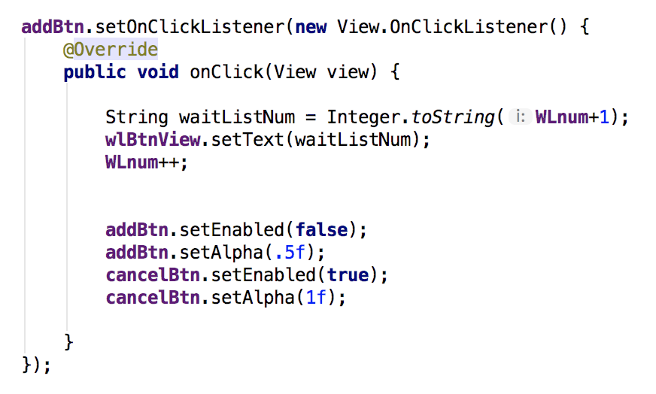





Details Page

